Slide 1
Traffic Flow Optimization Using Quantum Annealer
l

Slide 2
Team
Aarsh Oza
Dhaval Patel

Slide 3
The motivation behind the idea was to address a real world problem with a Quantum Computer

Slide 4
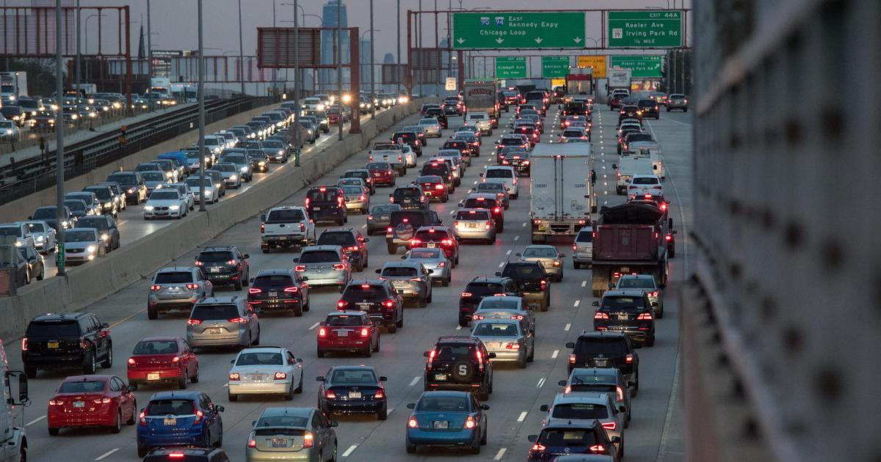

Do you like traffic jams???
Was your answer “yes”?

Slide 5
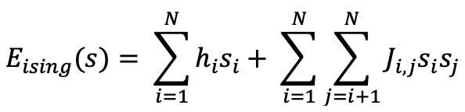
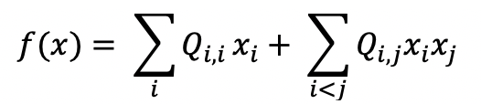
Approaches in Quantum Annealing
Ising Hamiltonian Equation
Quadratic Unconstrained Binary Optimization(QUBO)
Here the linear coefficients corresponding to qubit bias is h, while J is the quadratic coefficient corresponding to coupling strength.
Here Q is a square matrix of coefficients where the diagonal elements of the matrix represents the linear coefficient and the other non zero elements are the quadratic coefficient.

Slide 6
Why Qubo and Not Ising Hamiltonian
Both Ising Hamiltonian and Qubo are isomorphic meaning that the internal structure is interchangeable as we saw in earlier both encompasses of linear as well as quadratic coefficients.
We were to choose between a binary (0,1) approach and Ising Hamiltonian or spin (-1,1) approach. But we went ahead with QUBO just because of two main reasons:
(i) Qubo can be fully expressed in both expanded form of an equation and in matrix form, while Ising Hamiltonian cannot be expressed fully in matrix form.
(ii) Another motivation behind using QUBO was that we can simplify our cost and objective function as per binary rule i.e. x² = x because 0 and 1 squares are 0 and 1 respectively which cannot be the case in Ising Hamiltonian.

Slide 7
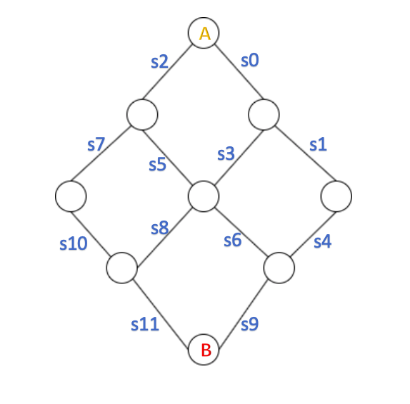
The Simplest case of traffic with 2 cars
Let there be a car1 which starts from ‘A’ with the goal of reaching ‘B’. It takes the route as follows: [s0,s3,s6,s9].
The other car2 also starts from ‘A’ for the same goal ‘B’. The route that car2 follows is: [s0,s3,s8,s11].

Slide 8
QUBO formulation for simple case
As one car taking a route is a unique event we map that event to binary variable Q_{ij} that car i taking route j. To keep things simple we are considering three routes for a car and thus in total we will have 6 variables for the simplified case:
The 3 routes for Car 1 are:
Q₁₁= s0,s3,s6,s9 (current route)
Q₁₂= s0,s3,s8,s11
Q₁₃= s2,s7,s10,s11
The 3 routes for Car 2 are:
Q₂₁= s0,s3,s6,s9
Q₂₂= s0,s3,s8,s11 (current route)
Q₂₃= s2,s7,s10,s11

Slide 9
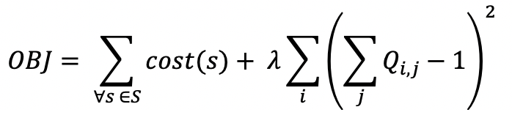
Minimizing Objective Function

Slide 10
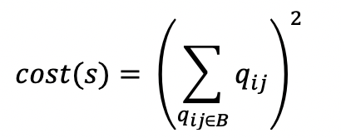
Cost function and congestion
We can comprehend from the graph we saw in previous slide that congestion occurs when more number of cars share a segment.
We already know that congestion on a segment is quadratic function of number of cars on that route.
∀ s ε S, all binary variables qij associated with same segment B_{s}. The cost function is:

Slide 11
Cost function value for segments
Q₁₁= s0,s3,s6,s9
Q₁₂= s0,s3,s8,s11
Q₁₃= s2,s7,s10,s11
Street Segment | Associated Cost Function | Value
s0 | (Q₁₁ + Q₁₂ + Q₂₁ + Q₂₂)² | 4
s3 | (Q₁₁ + Q₁₂ + Q₂₁ + Q₂₂)² | 4
s6 | (Q₁₁ + Q₂₁)² | 1
s9 | (Q₁₁ + Q₂₁)² | 1
s8 | (Q₁₂ + Q₂₂)² | 1
s11 | (Q₁₂ + Q₂₂ + Q₁₃ + Q₂₃)² | 1
s2 | (Q₁₃ + Q₂₃)² | 0
s7 | (Q₁₃ + Q₂₃)² | 0
s10 | (Q₁₃ + Q₂₃)² | 0
Q₂₁= s0,s3,s6,s9
Q₂₂= s0,s3,s8,s11
Q₂₃= s2,s7,s10,s11

Slide 12
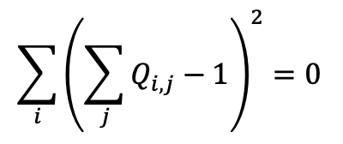
Constraints
The prime constraint in our case is that one car at a time cannot be present in more than one route. To simplify if Q₁₁ = 1 that is if the car 1 is present on route 1 then Q₁₂ and Q₁₃ are 0 that is the car 1 is not present in route 2 and 3.
As we have 3 alternate routes for a car, j can take values from {1,2,3} Thus the constraint can be formed mathematically as:

Slide 13
The Main Step
The main step in solving QUBO problem is minimizing objective function that we saw a couple of slides ago.
Objective function can be represented in matrix formulation as : 𝒙^{T}ᐧ𝑸ᐧ𝒙
Here 𝒙 is the column vector of all binary variables and Q is a upper triangular matrix of linear and quadratic coefficients.

Slide 14
The matrix 𝑸
Q₁₁= s0,s3,s6,s9
Q₁₂= s0,s3,s8,s11
Q₁₃= s2,s7,s10,s11
Q₂₁= s0,s3,s6,s9
Q₂₂= s0,s3,s8,s11
Q₂₃= s2,s7,s10,s11
There are four main rules to form the ‘𝑸’ matrix for some routes sharing same road segment s:
For every car i with possible route j, we add (−k) to the diagonal of Q given by index I(qij).
For every quadratic term arising from constraint equation, we add (2k) to the corresponding off-diagonal term.

Slide 15
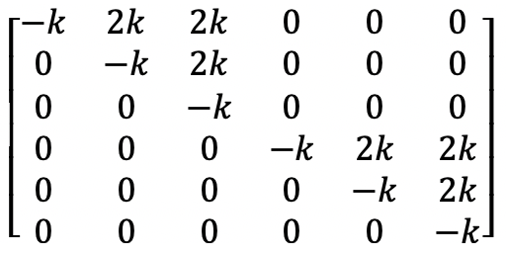
Finally we get 𝑸

Slide 16
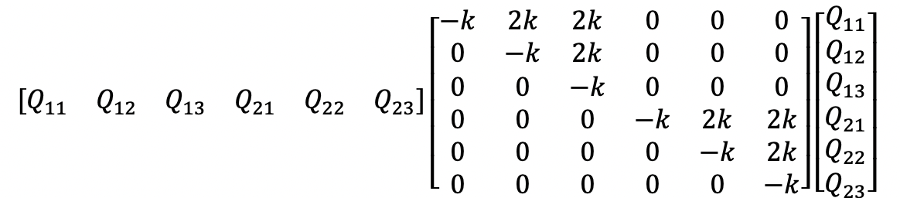
Solving
We can solve the QUBO problem at our disposal by minimizing objective function in other words minimizing 𝒙^{T}ᐧ𝑸ᐧ𝒙
QUBO returns the value of these 6 binary variables minimizing this matrix multiplication

Slide 17
Experimentation and Results
We created our own little dataset based on Microsoft’s T trajectory Dataset.
Where we took 100 cars into account running on our own created street map.
Here all the visible nodes are junctions.
Junction ‘A’ and ‘B’ are the starting and destination respectively.
Based on real scenario we modeled our problem where all cars start somewhere around same time with a goal to reach destination.

Slide 18
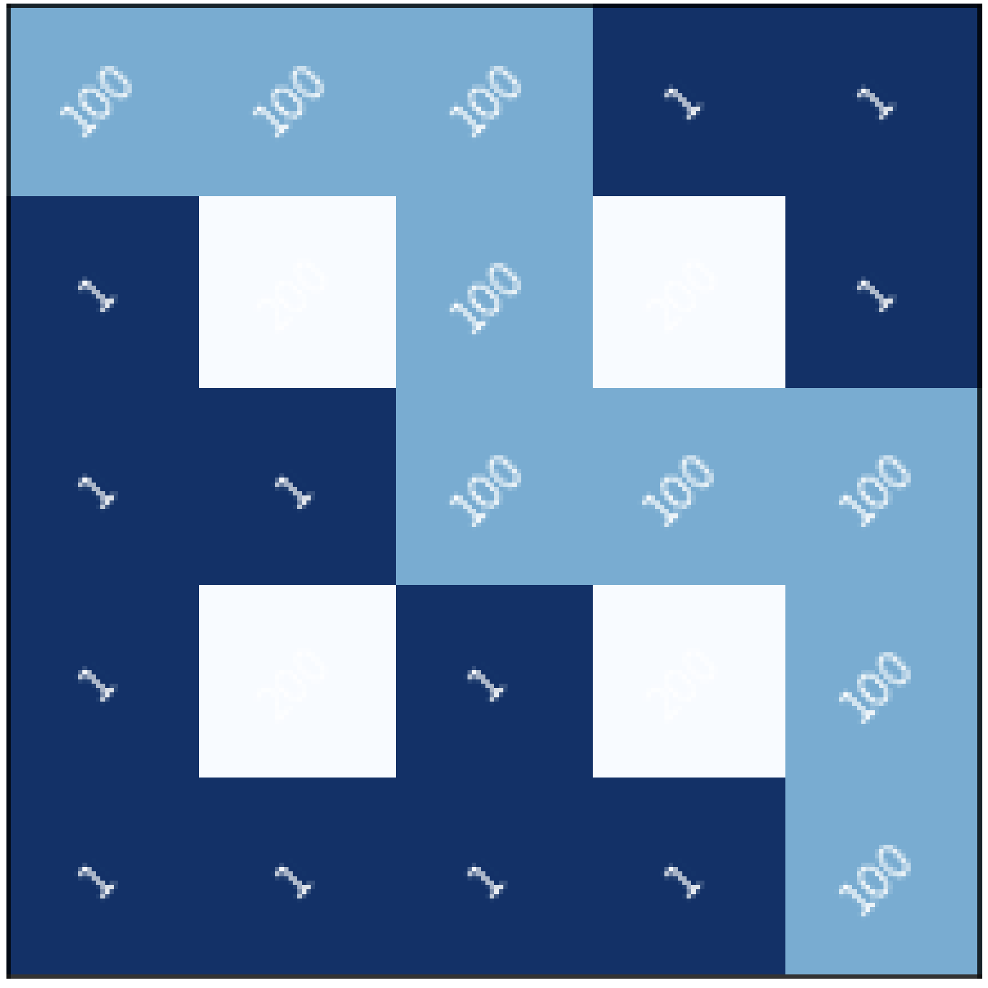
Results Continued
Following is the heatmap generated when all cars try to follow local optimum route given by existing classical algorithms like BFS and DFS.

Slide 19
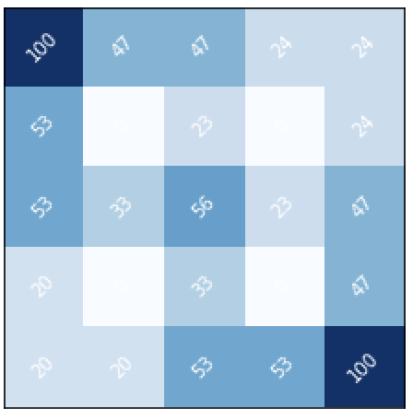
Optimized Result
We optimized the congestion encountered by distributing cars over some alternative routes suggested by our Quantum Annealing QUBO formulation.
Finally when we plotted the results on heatmap, we comprehended that the cars are distributed equally along all street segments achieving a global maxima and in turn reducing the congestion.

Slide 20
Thank you
Questions ???

